Slide 1
Can we make travelling easier?

Slide 2
Can we relieve the stress of cashless tourists on arrival?

Slide 3
Casual tourists

Slide 4
Introducing changeXchange

Slide 5
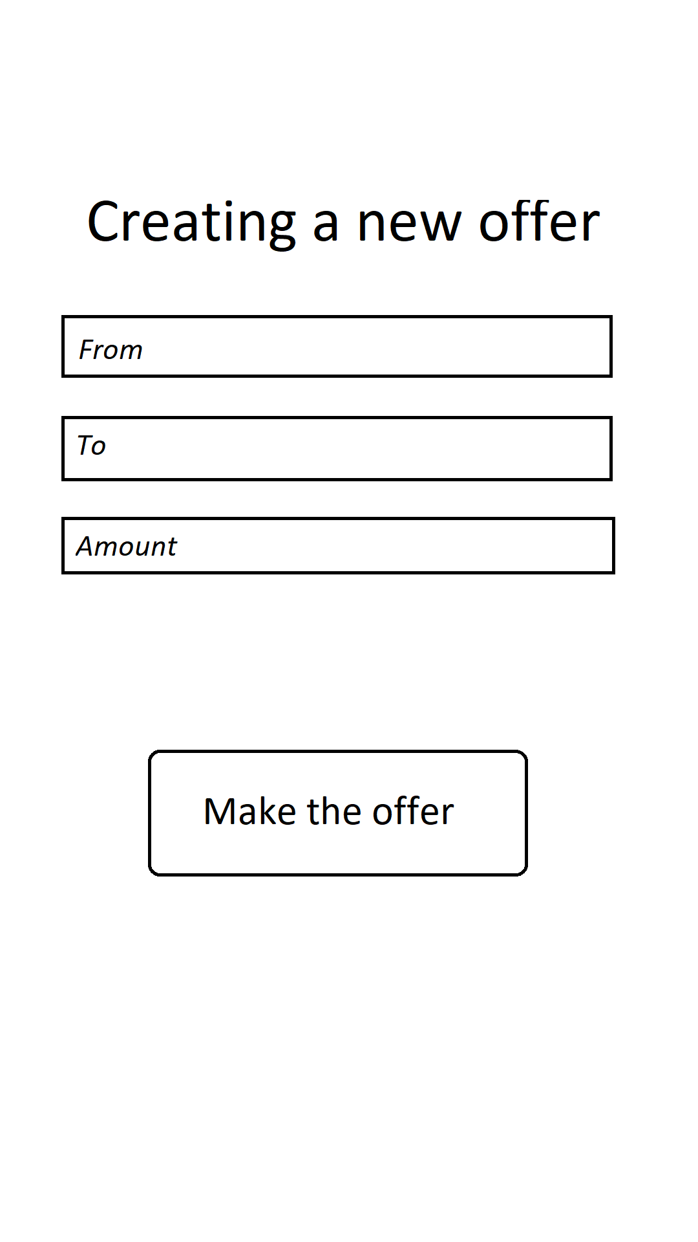
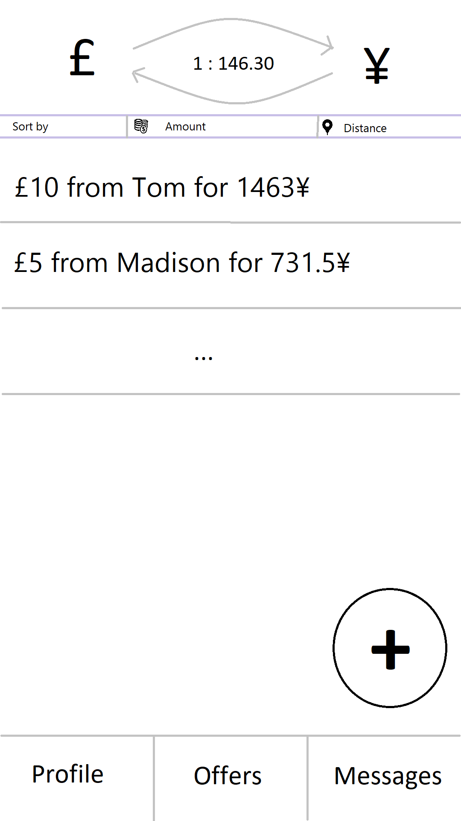
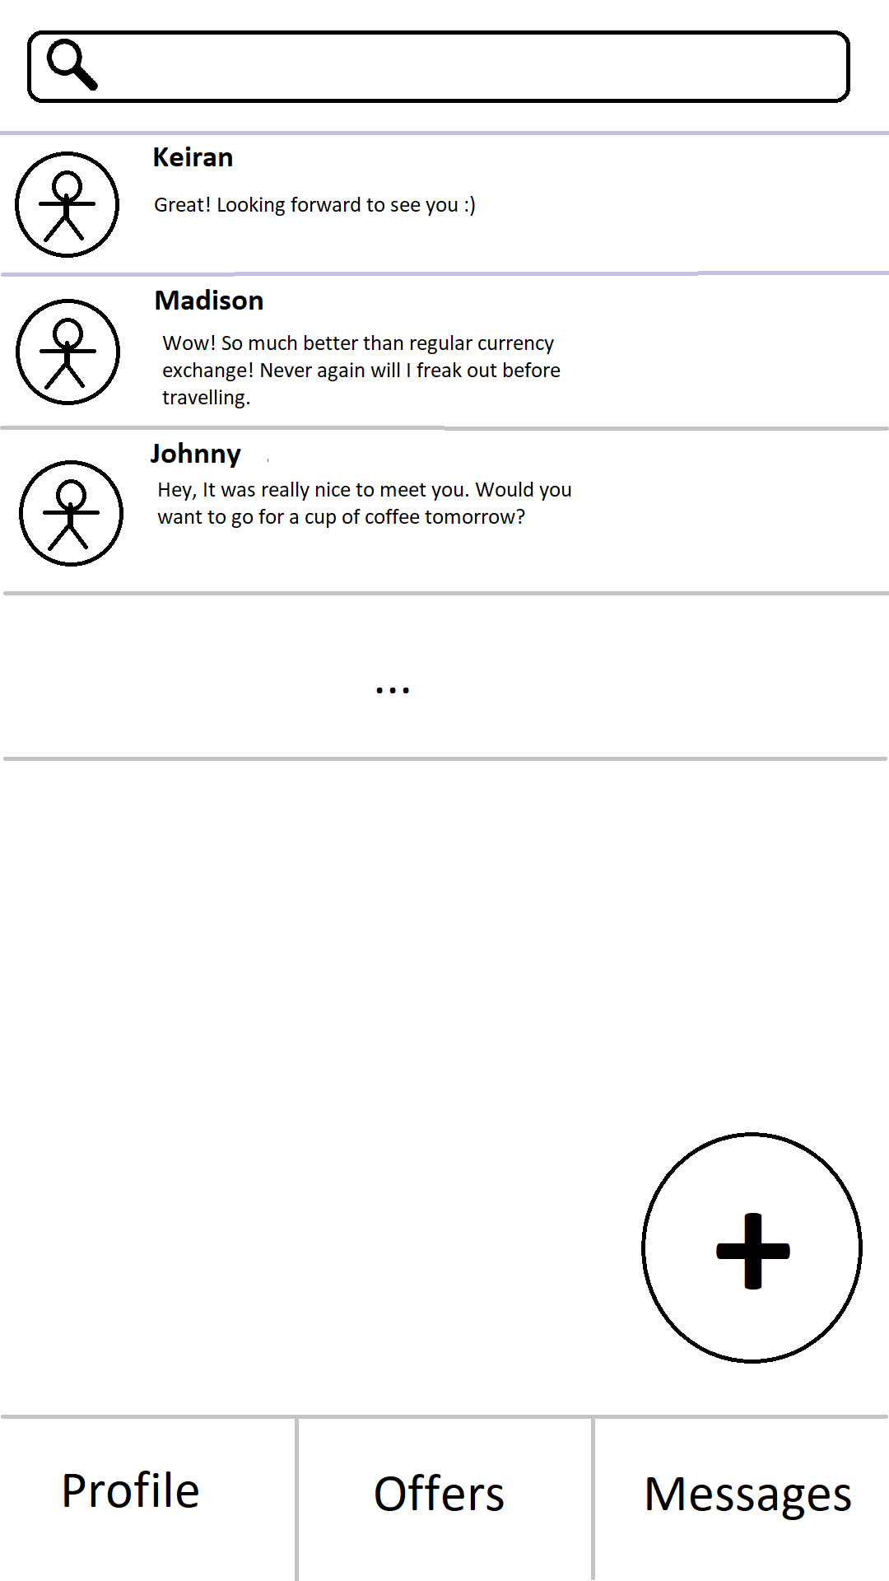
Mock-Ups

